Slide 1

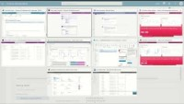
WORKFORCE OPTIMIZATION
Teams Integration for Business Events
Perform Workflow Approvals within Teams
Increased Collaboration: By performing workflow approvals within Microsoft Teams, team members can collaborate more efficiently, as all communication and decision-making related to approvals can be done in one place.
Improved Efficiency: Microsoft Teams allows for the creation of automated workflows that can be triggered based on certain events or actions.
Integration with other Microsoft Apps: Microsoft Teams integrates seamlessly with other Microsoft applications such as SharePoint, PowerApps, and Power Automate, allowing teams to use these apps to automate their workflows and streamline their processes.
Business Events + Microsoft Teams

